Slide 1
Digit Recognition in Street View House Numbers using Deep Convolutional Neural Networks
ANLY 535-50- A-2019/Late Fall - Machine Learning II
TEAM 4
Priya Singh
Aniket Naik Desai
Pooja Chopra
Aby Koshy
Aaina Malhotra

Slide 2
Overview
Multi-digit identification in photos taken at street-level is an important part of map building.
Google’s Street View imagery constitute of millions of geo-positioned 360-degree images.
Difﬁculty in identification occurs due to the broad variability in the presentation of the text and other environmental factors.
This Study focus on recognizing single digits in a real application by reading house numbers from street level photos using a CNN with multiple layers.
Fully Supervised approach unlike previous studies.
Keras and Tensorflow was used as two frameworks.
Tested the accuracy of the model by using the logistic regression, SVM and Random forest.

Slide 3
Related Works
Jaderberg, M., Simonyan, K., Vedaldi, A., & Zisserman, A. (2014). Deep structured output learning for unconstrained text recognition. arXiv preprint arXiv:1412.5903.
This study focused on recognizing words in natural images and uses CNN model which incorporates Conditional Random field graphical model taking whole word as single input.
Goodfellow, I. J., Bulatov, Y., Ibarz, J., Arnoud, S., & Shet, V. (2013). Multi-digit number recognition from street view imagery using deep convolutional neural networks. arXiv preprint arXiv:1312.6082.
This paper discusses on recognizing arbitrary multi-digit numbers from Street View imagery. It proposes a unified approach that integrates localization, segmentation and recognition steps via the use of a deep convolutional neural network that operates directly on the image pixels.

Slide 4
Problem Statement
Character recognition in documents with color concentration and various natural background are hard to recognize due to non-contrasting backgrounds, low resolution, Multiple numbers and blurred images.
This project specifically aims to develop a deep neural network to recognize individual digits in colored images centered around the digits and having distractions obtained from Street View House Number Recognition database

Slide 5
Data
SVHN - A real-world image dataset for developing machine learning and object recognition algorithms with minimal requirement on data preprocessing and formatting.
Built from house numbers extracted from house numbers in Google Street View images.
Consists of little over 73K images for train and 26K images for test.
The data contains label data with color information with various natural backgrounds.
The link to dataset is: http://ufldl.stanford.edu/housenumbers/.

Slide 6
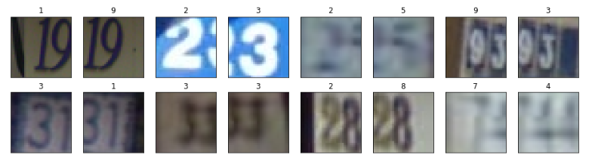
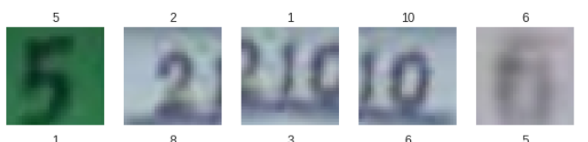
Exploratory Data Analysis
Train dataset images
Test dataset images

Slide 7
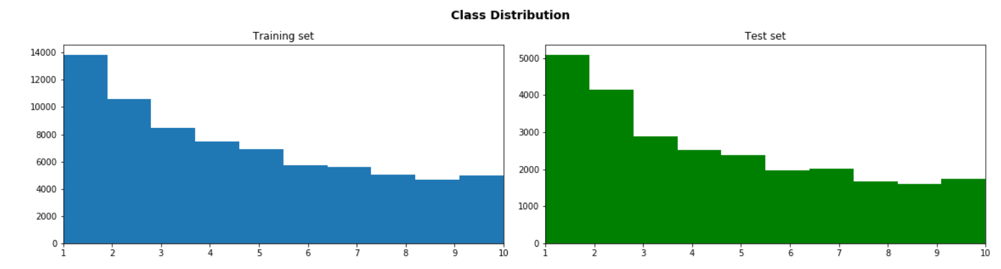
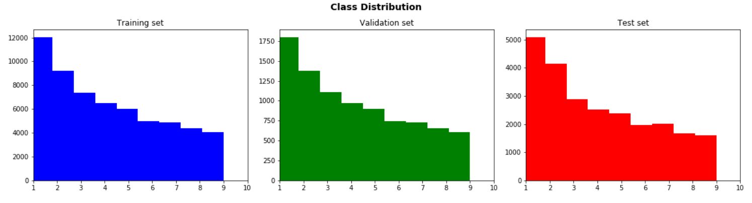
Exploratory Data Analysis
The below graphs shows the distribution of the frequency of the digits. We see that we have a high number of 1’s and 2’s compared to 6’s, 7’s, 8’s, 9’s, 10’s (10 is 0). The distribution have a positive skew.
Splitting 13% Train data into Validation data by using random state 7
New data distribution Train, Test and Validation dataset
RGB image Distribution
RGB image Distribution

Slide 8


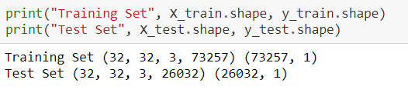
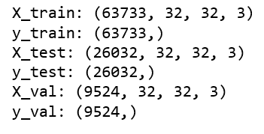
Data Preprocessing
32x32 cropped samples were used from the classification task of the SVHN dataset.
Total 10 Classes, 1 for each digit.
We have converted label 10 into 0
The data is split into X train, Y train, X test and Y test from the train and test data.
The data is then transposed into image arrays to convert the pixels values of each image in all of three channels(RGB).
Split train dataset into Validation + Train dataset
The labels (y) is one hot encoded to make them compatible with CNN
Added 1 channel of grayscale calculated from the RGB channels with the formula: Grayscale = R0.2990 + G0.5870 + B0.1140

Slide 9
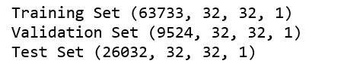
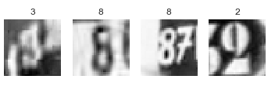
Data Preprocessing
Data distribution after Grey scale conversion.
The images are centered around the digits but since the images have been taken from real world, the images have distractions from parts of other digits. E.g. image of 9 has 1 included as distraction
We have normalized the data dimensions so that they are of approximately the same scale. Divide each dimension by its standard deviation, once it has been zero-centered.

Slide 10
Technical Approach
Used below two frameworks for our model:
Tensorflow:
Modeling by tensorflow using greyscale images
Modeling by tensorflow using non greyscale images
Keras
Modeling by Keras using greyscale images
Modeling by Keras using non - greyscale images
Improvement in the accuracy of the CNN models
Increasing number of layers
Dropout
Batch normalization

Slide 11
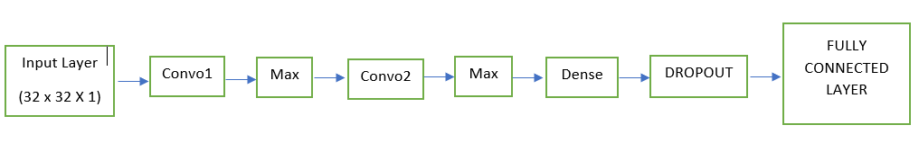
MODEL DESIGN - TENSORFLOW

Slide 12
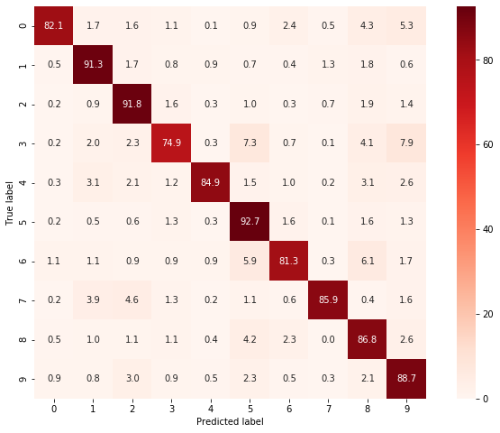
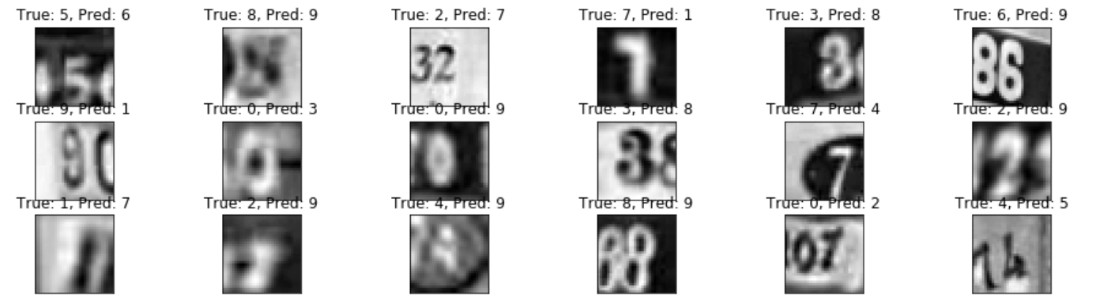
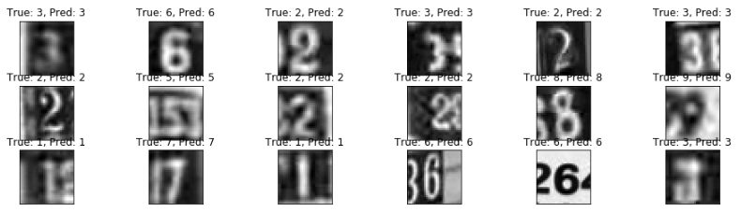
Grey Scale images
Confusion matrix:
Incorrect Classified images Correct Classified images
This approach was tested by using the confusion matrix and calculating the test accuracy of the model. As we can see most of the digit's classes are predicted correctly for grayscale images.

Slide 13
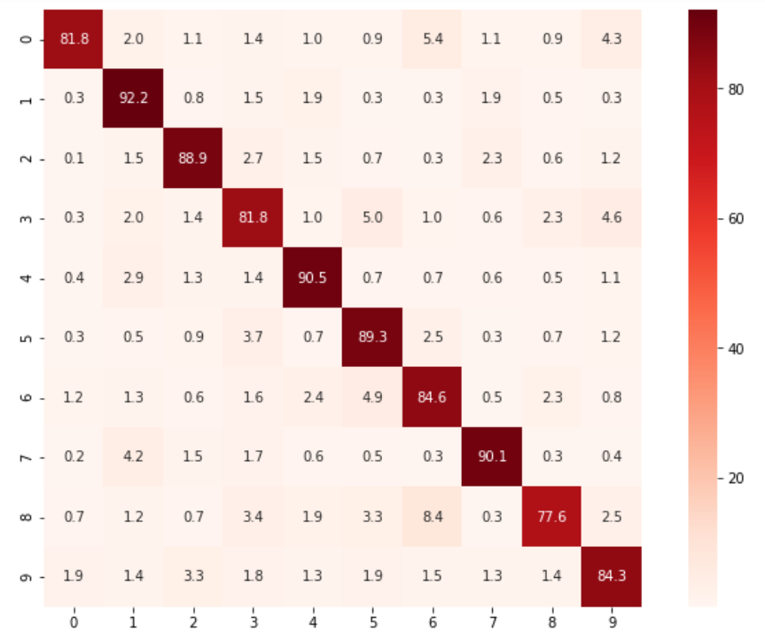
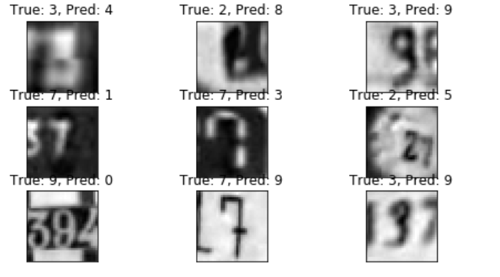
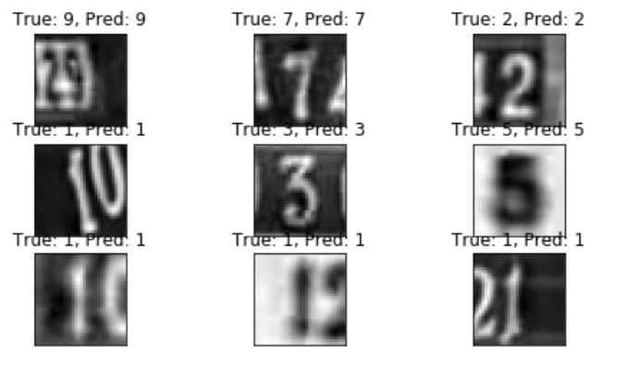
Non grey Scale images
Confusion matrix:
Incorrect Classified images Correct Classified images
This approach was tested by using the confusion matrix and calculating the test accuracy of the model. As we can see most of the digit's classes are predicted correctly for non grayscale images.

Slide 14
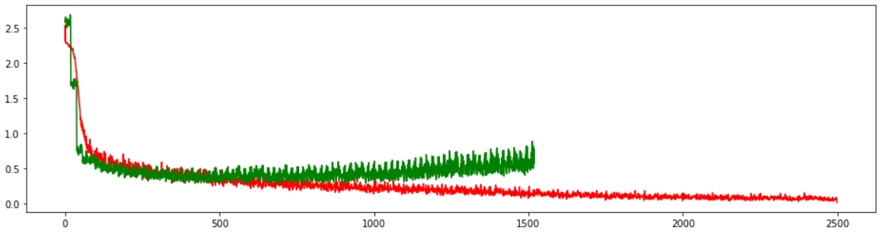
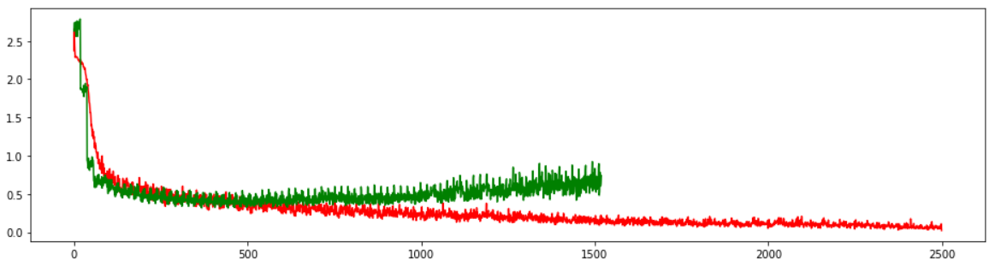
TENSORFLOW - Performance
Loss for Train and Validation
Grayscale Image
Batch_size = 512
Adam Optimizer
Accuracy on Test Data – 87.21 %
Most wrongly recognized Digit – 3 (confused with 2 & 5)
Non-Grayscale / Color Images
Batch_size = 512
Adam Optimizer
Accuracy on Test Data – 87.25 %
Most wrongly recognized Digit – 8 (confused with 6 & 9)
Red – Train
Green - Validation
Loss
Loss for Train and Validation
Red – Train
Green - Validation
Loss

Slide 15
Model Design - KERAS
Convolution Layer 1: Kernel Size 3 x3, Stride: 1, Output: 32 with relu function as activation
Max Pooling layer: pool window size 2 x 2,
Drop out layer :0.25
Convolution Layer 2: Kernel Size 3 x 3, Stride: 1, output: 64 with relu function as activation
Max Pooling layer: pool window 2 x 2,
Drop out layer :0.25
Convolution Layer 3: Kernel Size 3 x 3, Stride: 1, output: 64 with relu function as activation
Flatten Max Pool output
Dense layer with units 64 and relu as an activation
Dropout: 0.5
Dense layer with units 10 and softmax as an activation

Slide 16
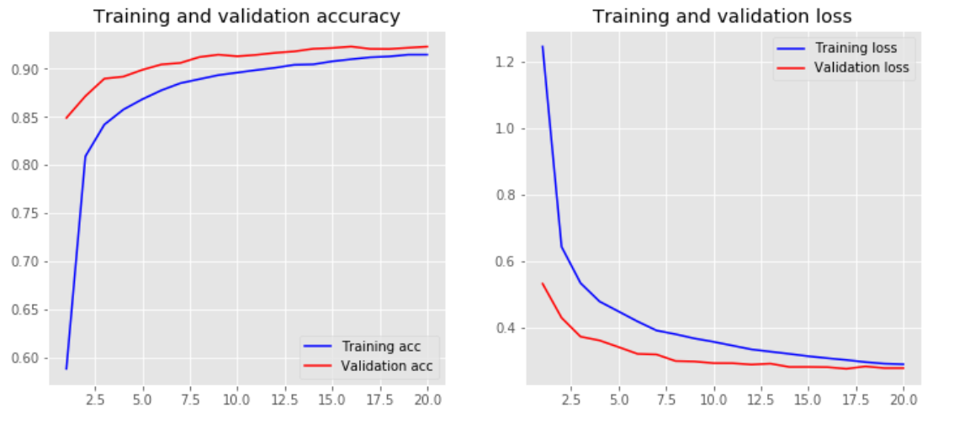
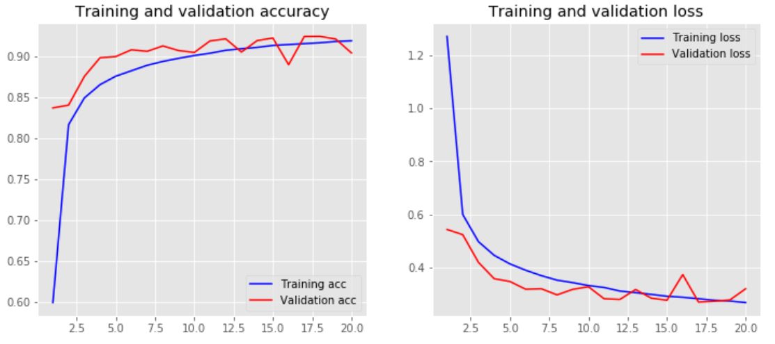
KERAS - Performance
For Grayscale Images
Grayscale Image
Model – I/P- {C-P-C-P-FC-FC}-O/P
Batch_size = 128
Adam Optimizer
Accuracy on Test Data – 92.19 % w/o batch norm
Non-Grayscale / Color Images
Model – I/P- {C-P-C-P-FLAT-FC-FC}-O/P
Batch_size = 128
Adam Optimizer
Accuracy on Test Data – 89.3 % w/o batch norm
Accuracy on Test Data – 91 % w batch norm
For Color Images

Slide 17
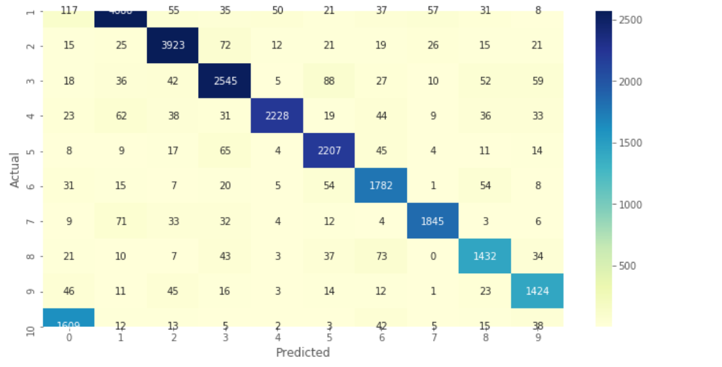
Digit Recognition in Non-Grayscale Images
This approach was tested by using the confusion matrix and calculating the test accuracy of the model. As we can see most of the digit's classes are predicted correctly for non grayscale images.
Confusion Matrix

Slide 18
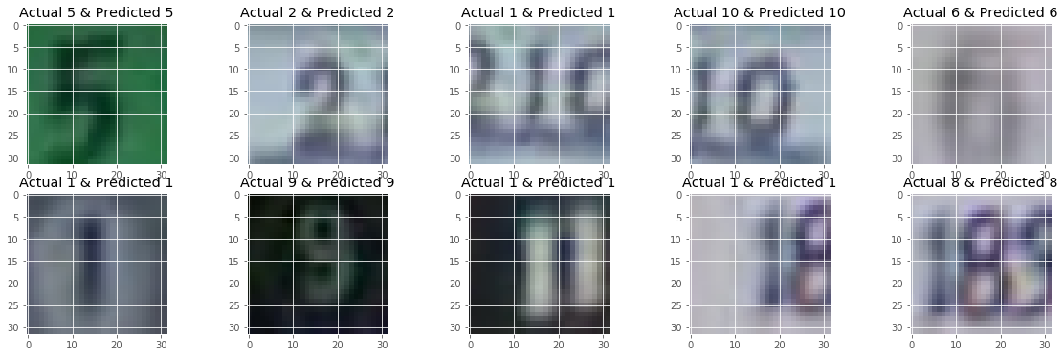
Digit Recognition in Non-Grayscale Images
Accuracy with non grey images was : 89% and validation loss was 38%. After using Batch normalization accuracy increased to 92% and validation loss decreased to 30%. Most of the digits were predicted correctly.
Digit Recognition

Slide 19
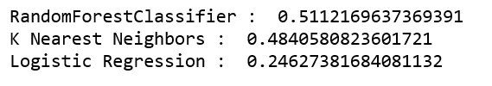
Comparison
We compared the performance of the CNN models against other machine learning algorithms by converting the four-dimensional data to two-dimension data for the PCA to compute on x train data.

Slide 20
Conclusion
Model – I/P- {C-P-C-P-FLAT-FC-FC}-O/P on Color images with Adam optimizer, batch normalization, and dropout gives accuracy of 91%
Model – I/P- {C-P-C-P-FLAT-FC-FC}-O/P on Grey images with Adam optimize and dropout gives highest accuracy of 92%
A higher number of layers increase the accuracy
Gray scaling does improve the accuracy of the model
Batch normalization and dropout improve the accuracy of the model
Future work, to be focused on using the weights from MNIST data and use those on SVHM data.
Exploring more architectures will help in classifying the original images and using different frameworks like PyTorch will help run the model.

Slide 21
Thank You

